Slide 1
DDOS ATTACK DETECTION & MITIGATION

Slide 2
Problem Statement
Problem Statement
Distributed Denial of Service (DDoS) attacks involve overwhelming a target system with a huge volume of traffic from multiple sources. This disrupts normal service operations, causing downtime and loss of availability for legitimate users. Detecting and mitigating these attacks in real time is challenging because of the attack's scale, diversity, and the difficulty in distinguishing between legitimate and malicious traffic.
Problem Description
DDoS attacks leverage large networks of compromised devices, known as botnets, to generate massive traffic floods targeting websites, servers, or networks. These floods exhaust resources, degrade performance, and can cause complete service outages. Existing security solutions often fail to accurately detect these attacks early or mitigate them efficiently without blocking genuine users. Therefore, there is a critical need for advanced detection and mitigation techniques that can identify abnormal traffic patterns quickly and respond effectively to maintain service availability and protect business operations.

Slide 3
Abstract
Distributed Denial of Service (DDoS) attacks are one of the most common and disruptive cyber threats, targeting online services by flooding them with a massive volume of traffic from multiple compromised sources. These attacks cause severe service disruptions, leading to downtime, loss of revenue, and damage to reputation. Detecting and mitigating DDoS attacks in real-time is challenging due to the increasing scale and sophistication of attack methods, as well as the difficulty in differentiating between legitimate and malicious traffic. This project aims to design and implement a comprehensive detection and mitigation framework that monitors network traffic patterns, identifies abnormal behaviors using threshold and anomaly detection techniques, and applies automated mitigation strategies such as rate limiting, IP blocking, and traffic filtering. The ultimate goal is to maintain service availability, reduce false positives, and provide a scalable defense mechanism against evolving DDoS threats.

Slide 4
Literature Survey
Traditional Detection Methods: Use signature-based and threshold-based techniques to identify known DDoS patterns but often fail against new or sophisticated attacks.
Anomaly Detection Approaches: Employ statistical analysis and machine learning to detect abnormal traffic behavior, improving accuracy in identifying unknown attacks.
Mitigation Techniques: Include rate limiting, IP blacklisting, traffic filtering, and challenge-response systems like CAPTCHAs to reduce attack impact.
Cloud-Based Solutions: Services like AWS Shield and Cloudflare offer scalable protection by filtering traffic through global networks.
Research Gaps: Existing methods face challenges in real-time detection, low false positives, and distinguishing between legitimate and malicious traffic during high traffic loads.

Slide 5
Existing Systems
Signature-Based IDS (e.g., Snort): Detects known attack patterns but struggles with new or evolving threats.
Rate Limiting & Firewall Rules: Basic filtering to limit traffic from suspicious sources; effective but can block legitimate users.
Cloud-Based DDoS Protection: Services like Cloudflare, AWS Shield, and Azure DDoS Protection provide scalable, real-time traffic filtering and scrubbing.
Machine Learning-Based Systems: Use anomaly detection and classification algorithms to identify and respond to DDoS attacks dynamically.
Scrubbing Centers: Redirect traffic through specialized networks to filter out malicious requests before reaching the target.

Slide 6
Limitations
Signature-Based Systems: Unable to detect new or evolving attack patterns effectively.
High False Positives: Legitimate traffic may be mistakenly blocked during mitigation.
Scalability Issues: Some systems struggle to handle very large-scale attacks.
Delayed Response: Real-time detection and mitigation can be challenging, causing service disruption.
Resource Intensive: Advanced detection methods, like machine learning, require significant computational power.

Slide 7
Advantages
Early Detection: Identifies attacks quickly to minimize downtime and damage.
Real-Time Mitigation: Helps maintain service availability by blocking malicious traffic promptly.
Improved Accuracy: Anomaly-based methods reduce false positives compared to signature-based detection.
Scalability: Cloud-based solutions can handle large-scale DDoS attacks efficiently.
Automated Response: Minimizes human intervention, allowing faster and consistent defense.

Slide 8
Proposed System / Innovation
Hybrid Detection Approach: Combines signature-based and anomaly-based methods for improved accuracy.
Real-Time Traffic Analysis: Continuously monitors network traffic to detect abnormal patterns promptly.
Machine Learning Integration: Uses advanced ML models to adaptively identify evolving attack behaviors.
Automated Mitigation: Implements rate limiting, IP blocking, and traffic filtering without manual intervention.
Scalable Cloud Deployment: Leverages cloud infrastructure for handling large attack volumes efficiently.
Low False Positive Rate: Balances security with user experience by minimizing legitimate traffic disruption.

Slide 9
USECASE DIAGRAM

Slide 10
CLASS DIAGRAM

Slide 11
SEQUENCE DIAGRAM

Slide 12
COLLABORATION DIAGRAM

Slide 13
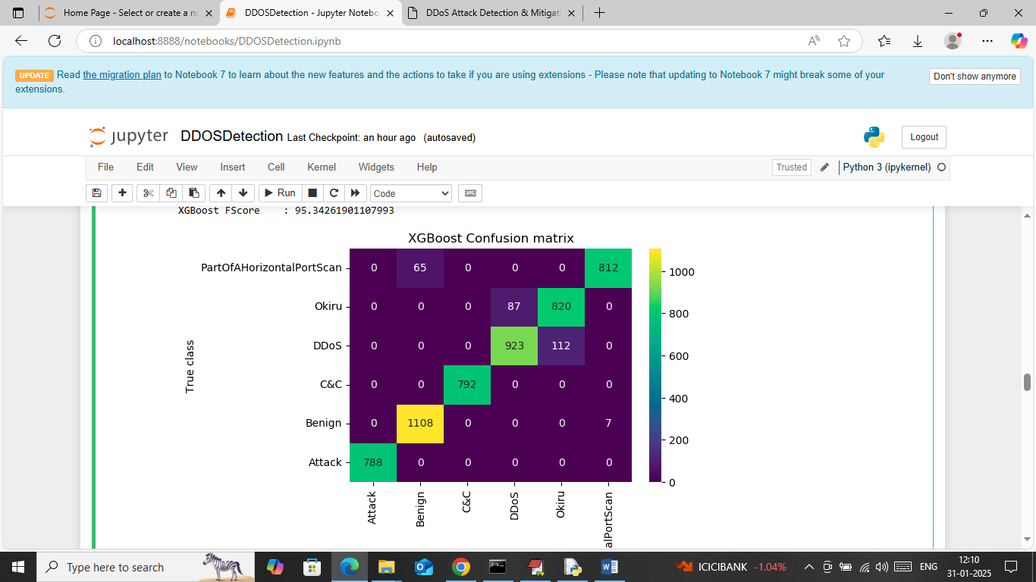
SCREENSHOTS

Slide 14
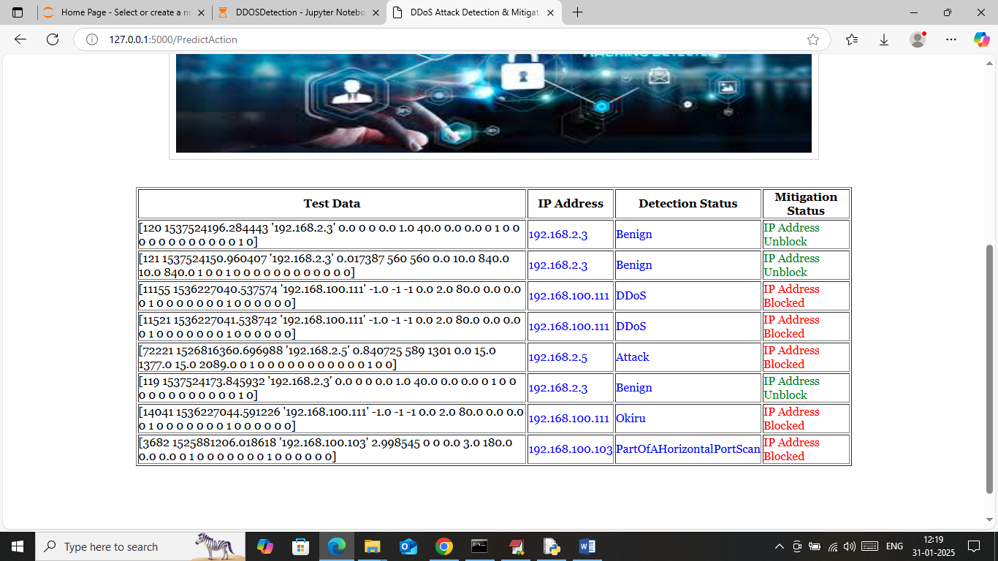

Slide 15
THANK YOU

